Slide 1
OBJECT ORIENTED ANALYSIS AND DESIGN PROJECT PRESENTATION VOZILO
GROUP MEMBERS
Anas Yasin [16K-3822]
Mudassir Latif [16K-3811]
Adil Ayub [16K-3834]

Slide 2
OVERVIEW
The project deals with today’s parking problems efficiently by utilizing a clear database and managing it through different aspects. Following project can record, store and manage incoming and outgoing vehicles from the parking lot.
It makes sure security by checking CPLC status of incoming vehicle by using authenticate government websites and deciding whether to inform user or not about the CPLC status of vehicle.
It does so by efficiently recognizing license plate of the vehicle and converting it into a valid string using machine learning.
Finally it inserts fetched data into the database along with some other credentials which are helpful to manage today’s huge parking lots, organization’s parking(s).

Slide 3
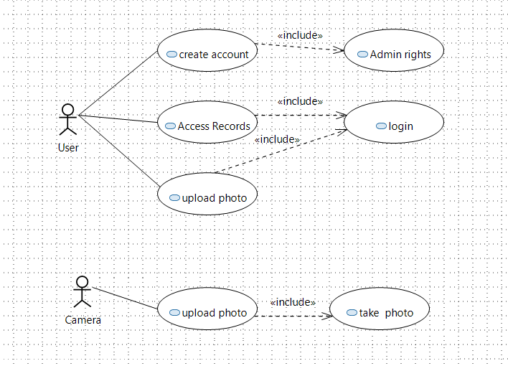
USE CASE DIAGRAM
login
login
*Upload Photo includes selecting from existing directories.

Slide 4
WORK DIVISION
Name | Task
Anas Yasin | Insert Queries
 | OCR and Webcam Module
Mudassir Latif | Table Create Queries
 | GUI Module
Adil Ayub | Selection Queries
 | Web-Scraping Module
*OCR is a model based on tesseract, a machine learning model.

Slide 5
THANK YOU

